Slide 1

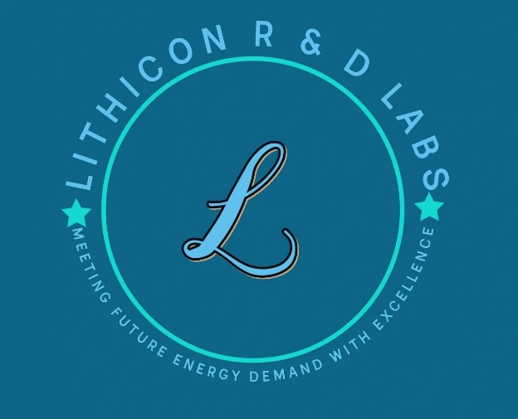

Driving Economic Transformation in Africa Through Electrification
Lithicon R&D Labs and Affiliates. All Rights Reserved.

Slide 2
About Us
In response to rising electricity demand driven by industrial growth and population increase,
Lithicon aims to play a critical role in assisting to electrify Africa and other emerging regions. As
an energy service company, Lithicon offers reliable and affordable energy solutions to
commercial and industrial customers in emerging markets. We offer scalable energy systems
tailored for local conditions, offering both power generation and energy storage plus asset
leasing solutions to customers. As an advantage, our energy solutions allow customers to
replace costly diesel generators to mitigate carbon emissions while reducing costs.
Record videos

Slide 3
Products and Services
We offer scalable power generation and energy storage solutions to support applications in
commercial &amp; industrial settings, including commercial facilities, manufacturing plants, mining installations, data centers and other facilities such as schools, health centers and charging
stations for electric motorcycles. Also, we support rural electrification efforts by developing solar
PV microgrids in remote areas to provide reliable and affordable electricity for community use
and rural industrialization.
Further, Lithicon also offers grid infrastructure services including capacity and ancillary services
such as frequency regulation, voltage control, fault current support, reserves management,
congestion relief and other services to support grid stability.

Slide 4
As a trusted energy service provider and system integrator, Lithicon brings local knowledge and
service expertise to projects, allowing for efficient installation and responsive support. Our
power generation and energy storage solutions include performance guarantees to ensure
customers get value for money while minimizing downtime and costs. Our energy services
include:
Provision of backup power support to maintain critical operations during power outages by
supplying uninterrupted electricity from high-performance battery energy storage systems
connected to solar PV or other reliable power source.
Provision of off-grid power solution by pairing solar PV with battery energy systems, especially in remote areas without grid access.
Renewable energy integration, allowing for storage of excess solar, wind and geothermal power
to minimize curtailment and maximize asset usage.
Provision of grid ancillary services including frequency regulation, voltage control, fault-current
support and other critical services to maintain grid stability.
Boosting grid capacity by deploying utility scale energy storage assets to minimize congestion
related costs along transmission corridors.

Slide 5
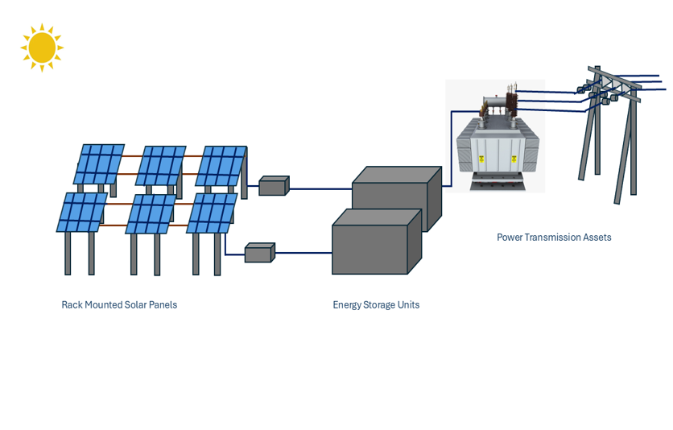
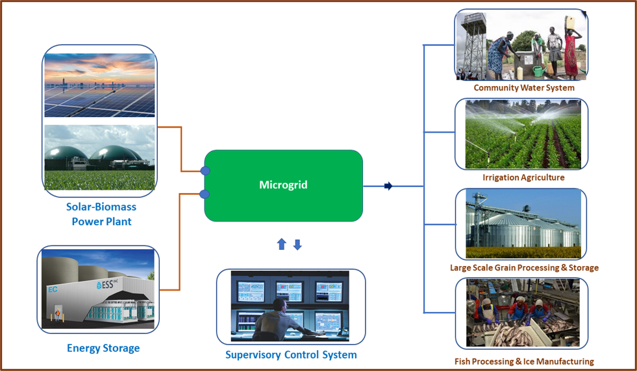
Ongoing Solar Microgrid Project
Solar Microgrid Project will provide reliable and affordable electricity to support community development and value addition activities in key sectors, especially agriculture and fisheries in the region.
Proposed solar PV microgrid to support will support community development, irrigation agriculture and industrialization activities including agro-processing and fish production.
Schematic of Proposed Solar PV Microgrid in Northern Uganda.

Slide 6

Meeting Future Energy Demand with Excellence
U.S.A –Parent Company
Lithicon R&D Labs
10900 Research Blvd, Suite 160C
Austin, TX 78759
Uganda-Affiliate
Lithicon Technology Co. Limited
Plot 11 Mpanga Close
Bugolobi, Kampala
Contact
info@lithiconrdlabs.com

Slide 7
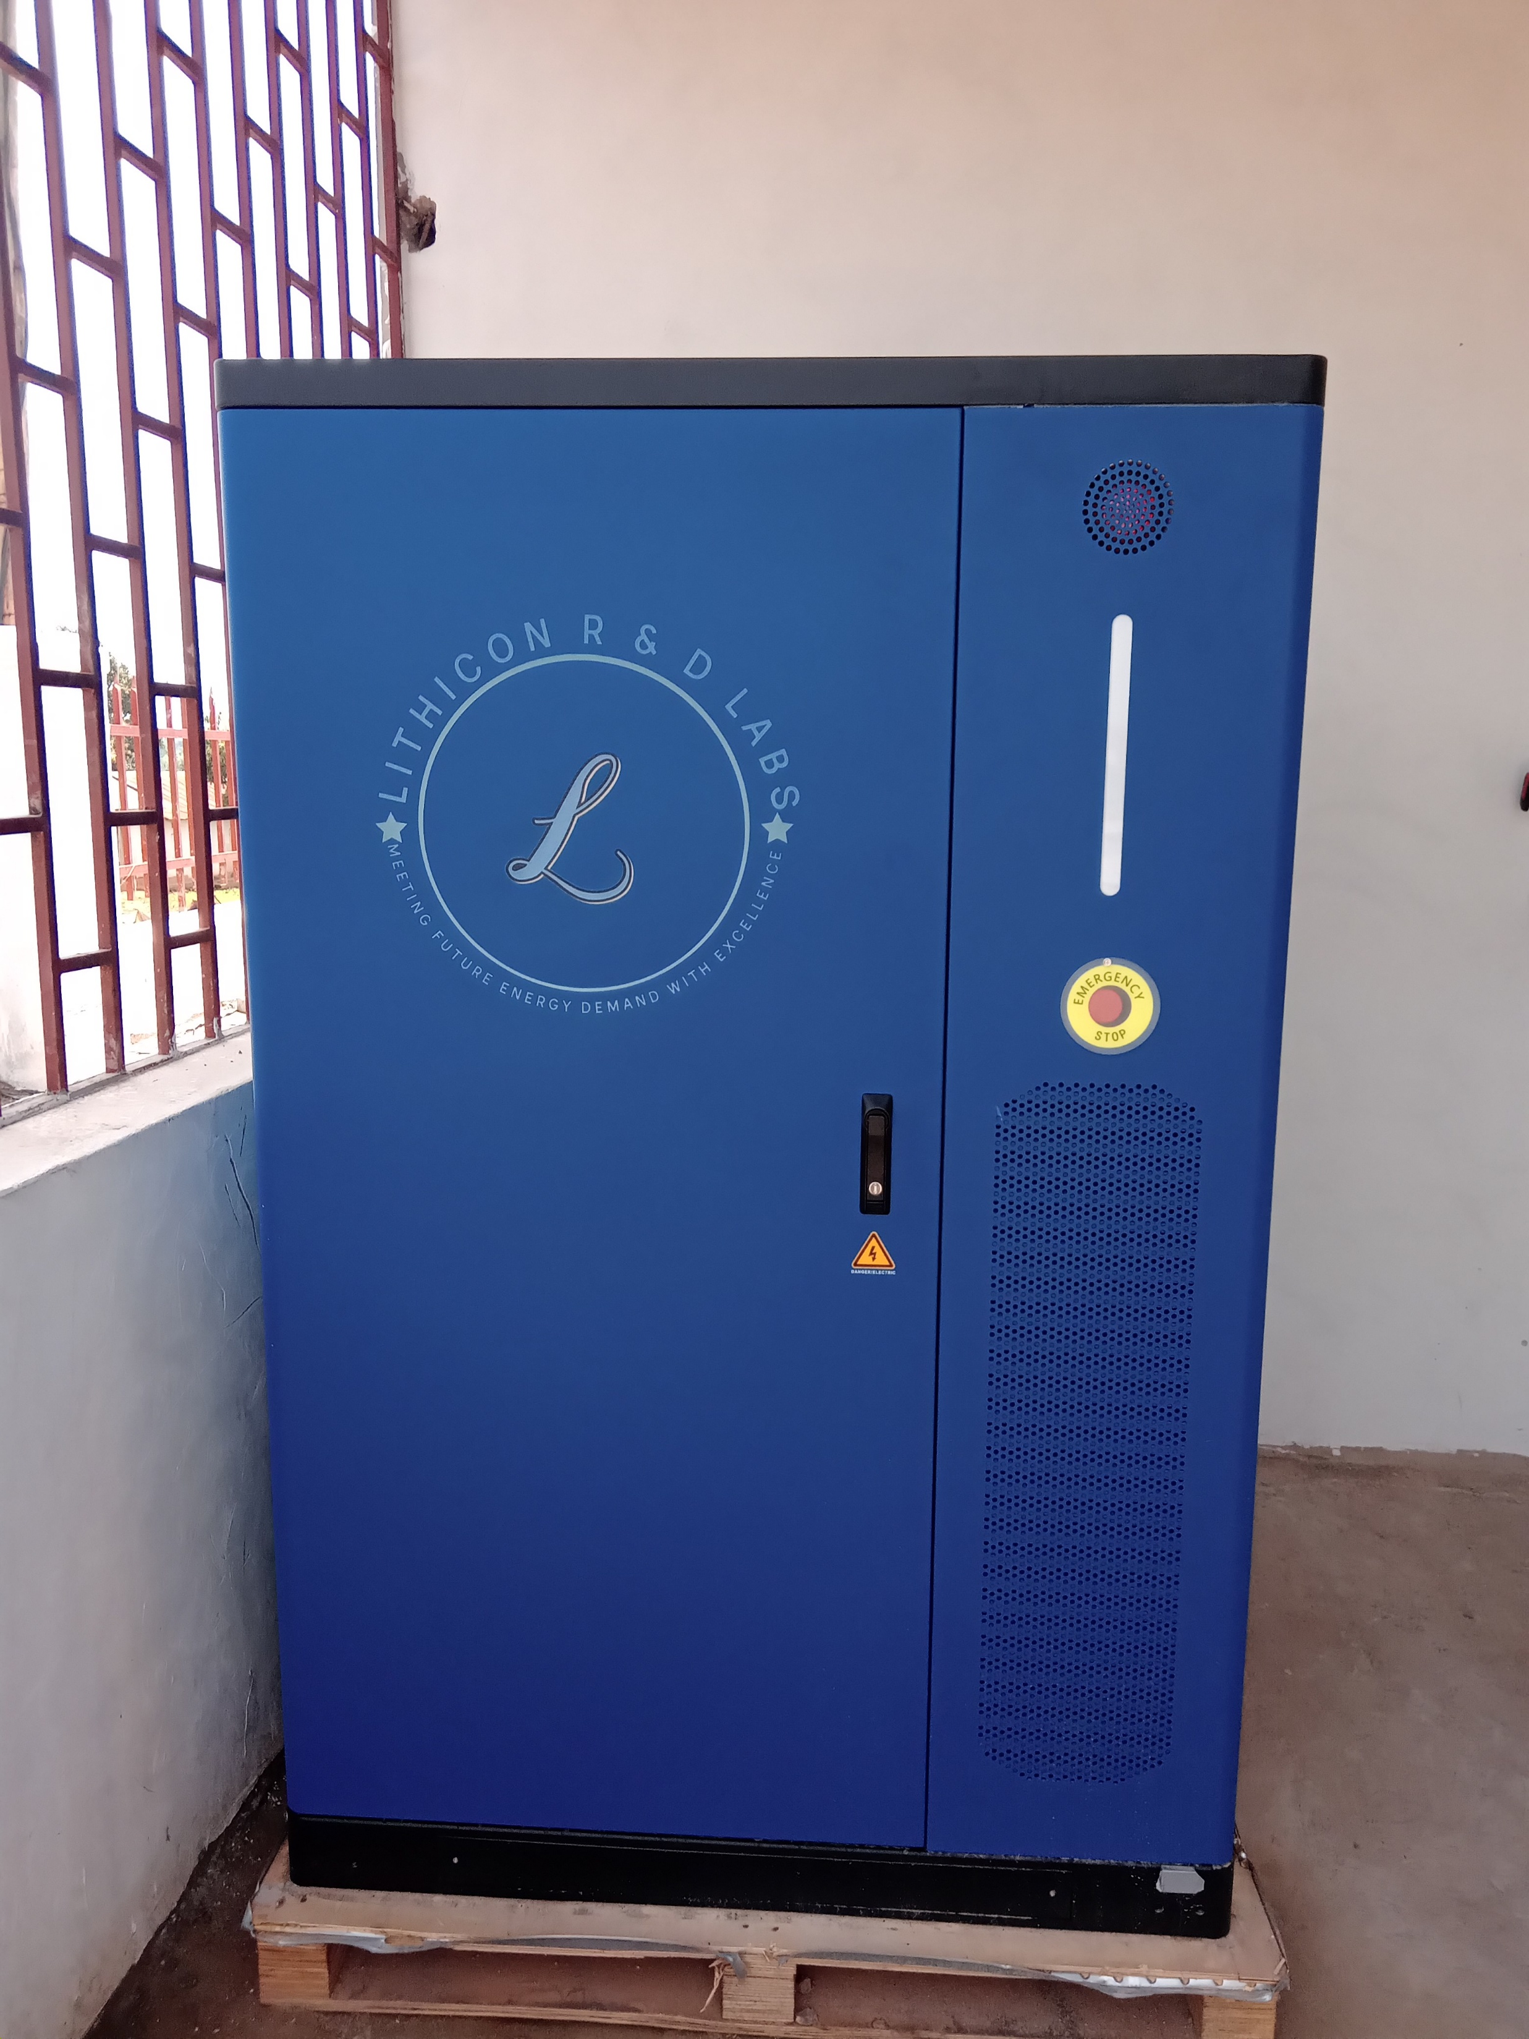

Slide 8
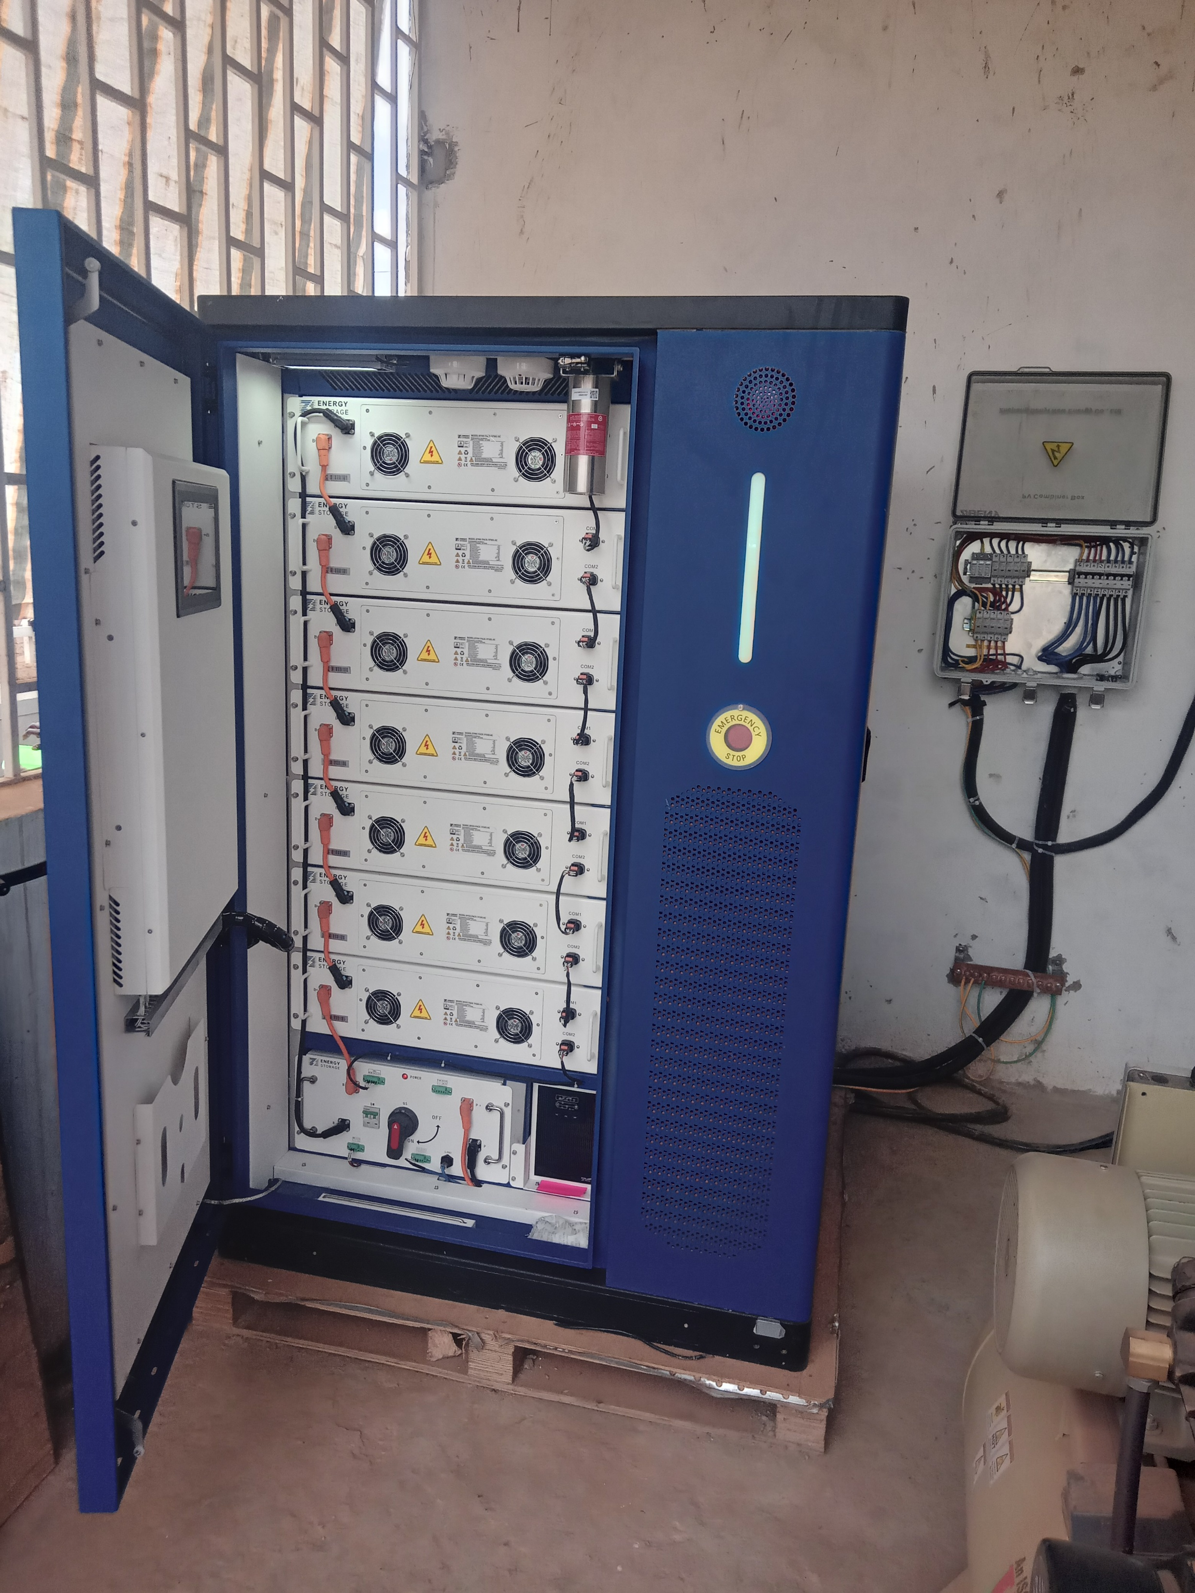

Slide 9
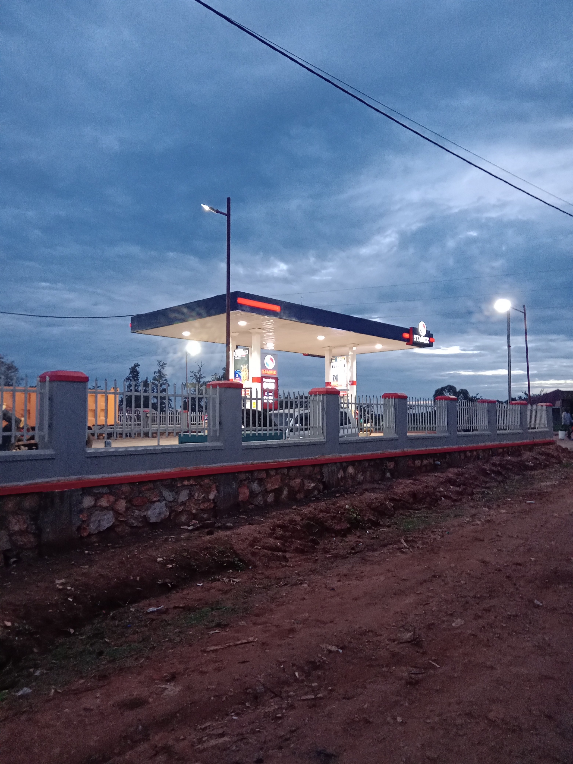

Slide 10
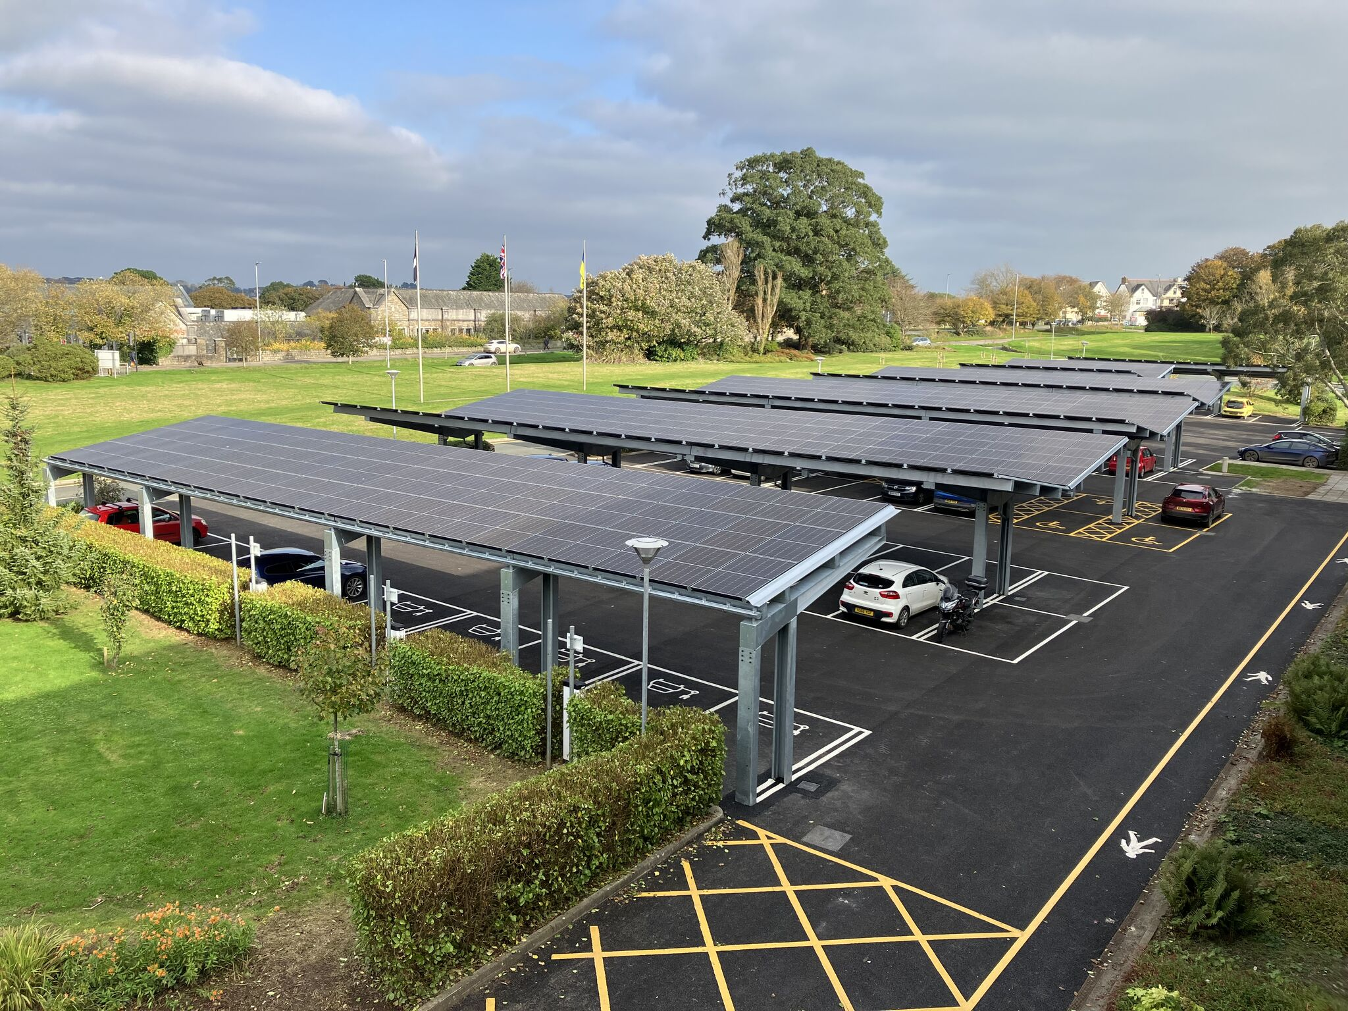

Slide 11
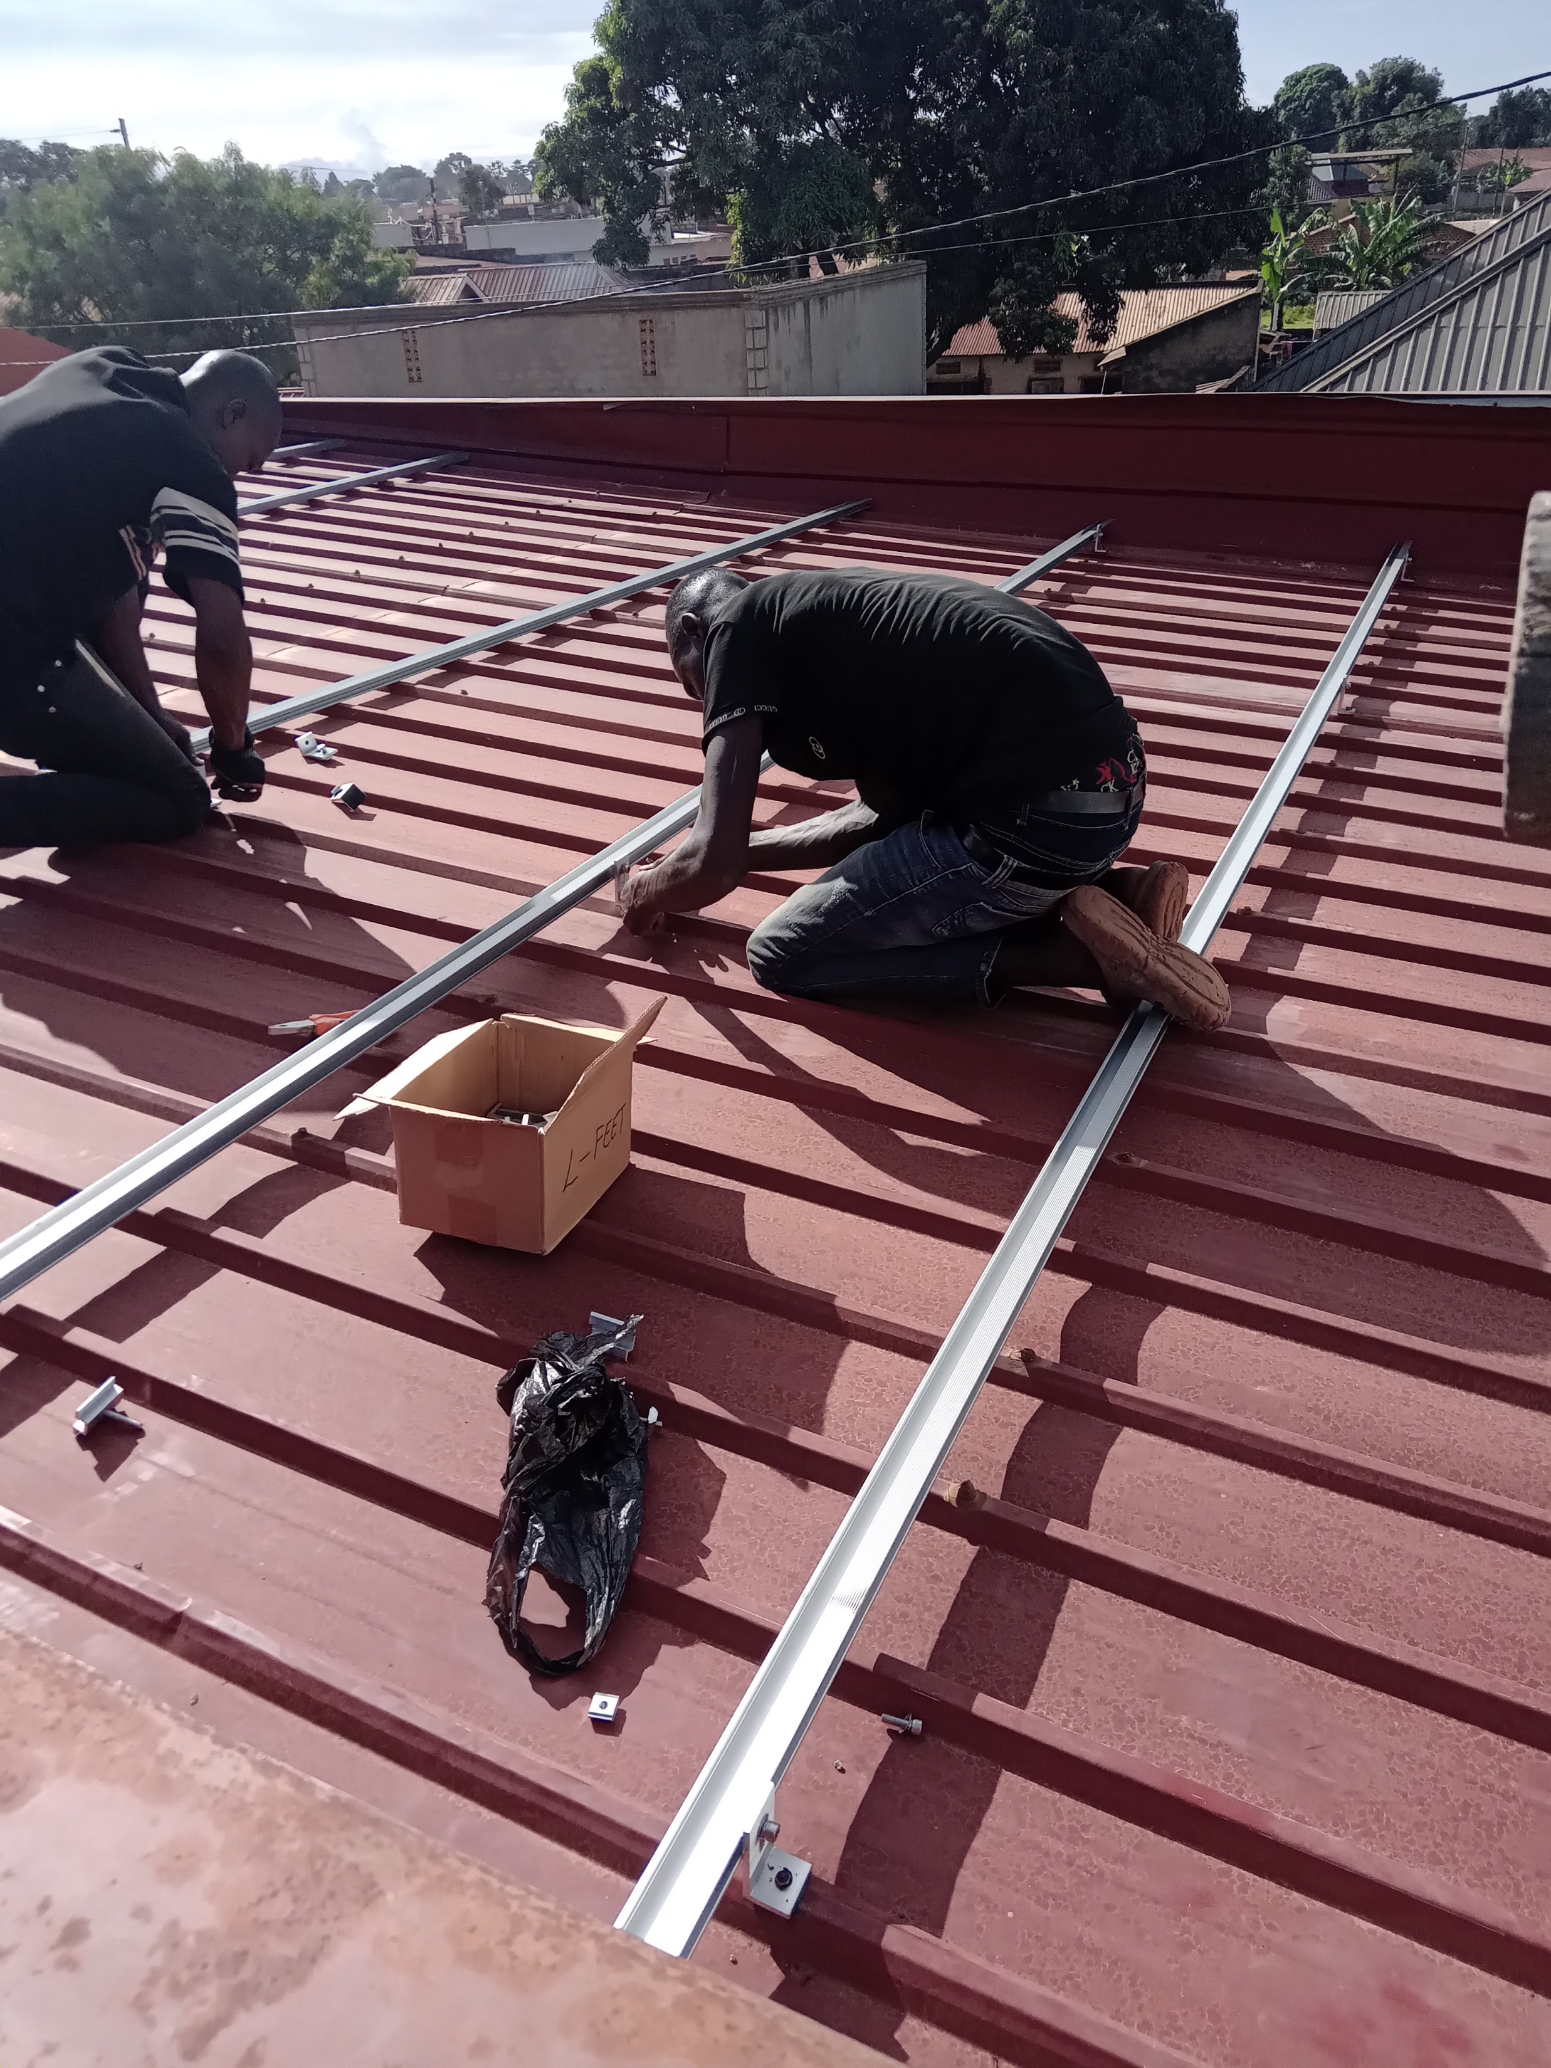

Slide 12
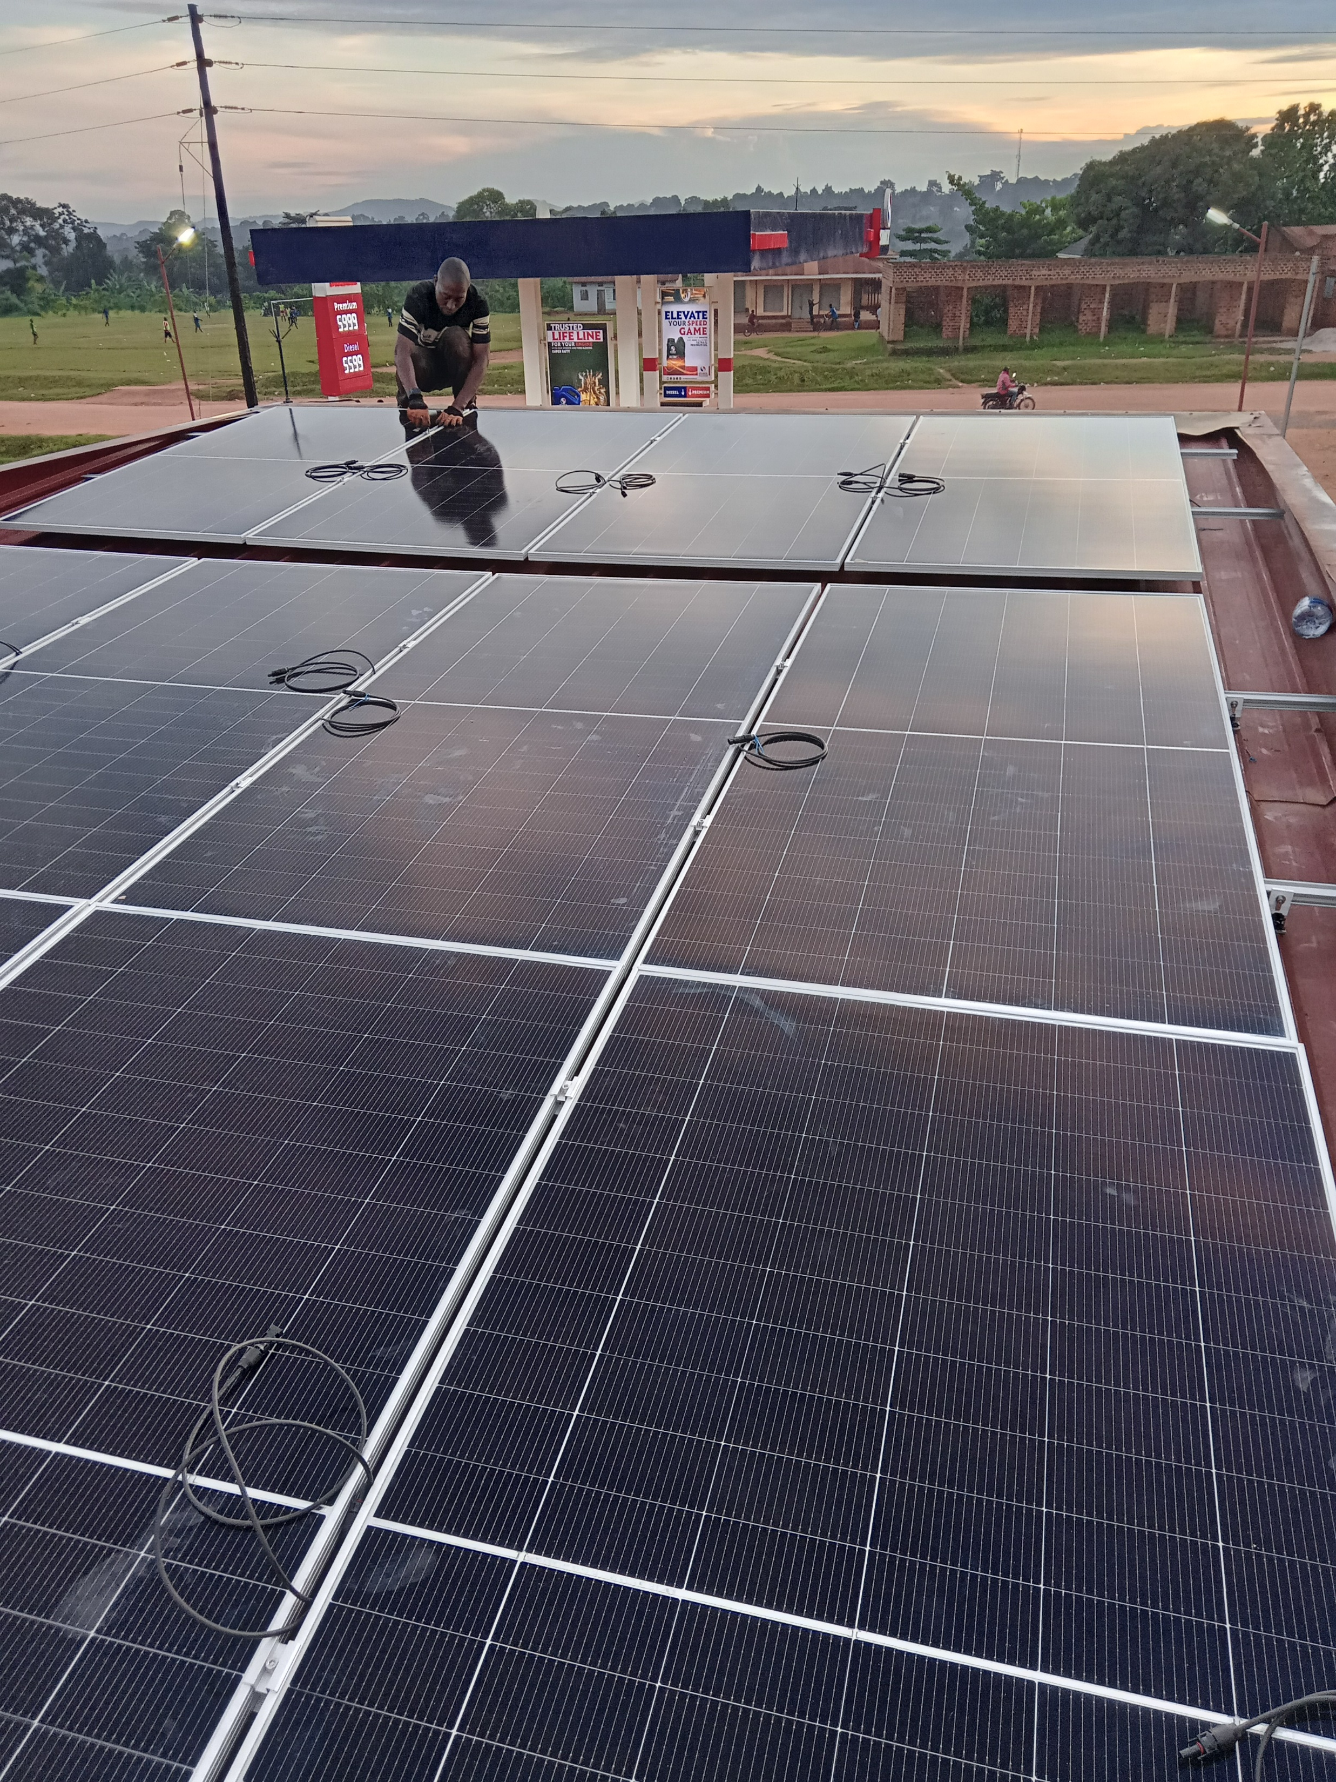

Slide 13
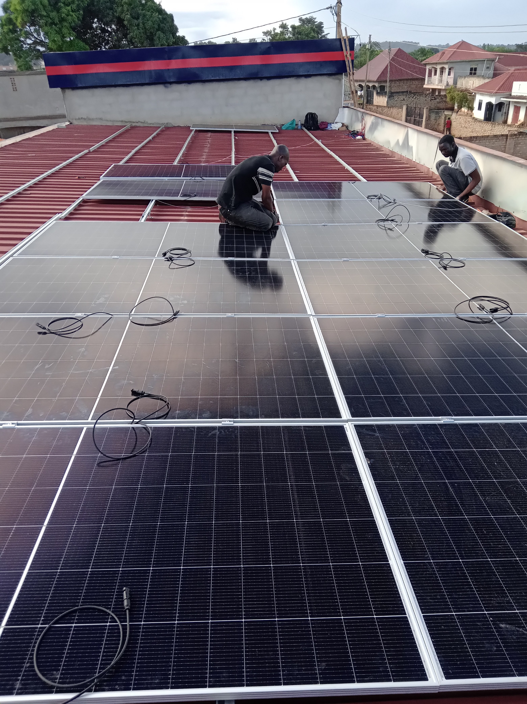

Slide 14
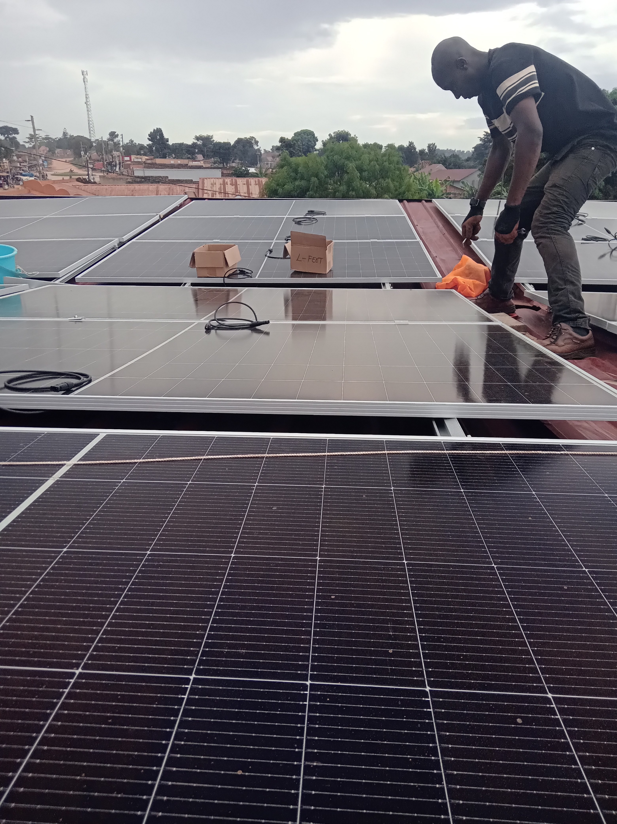

Slide 15
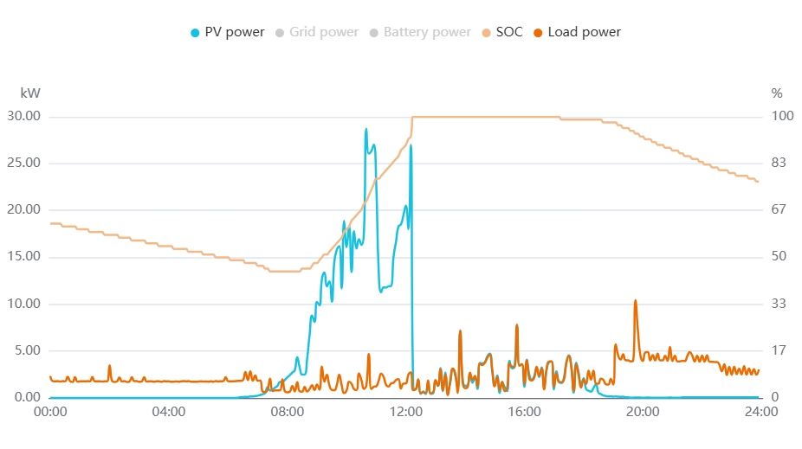
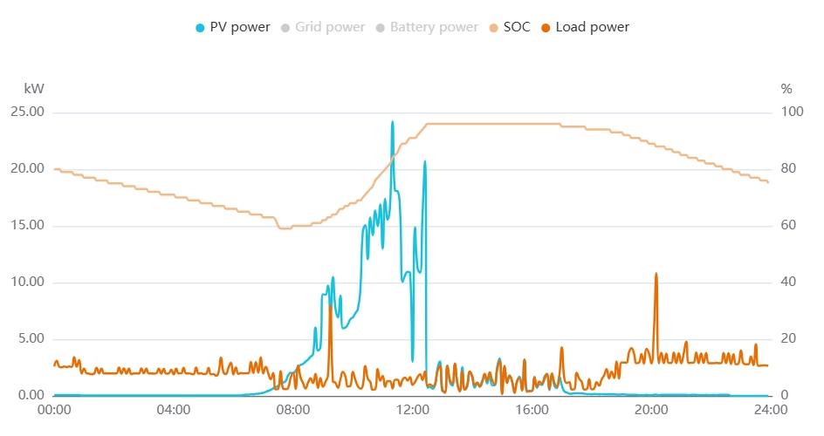
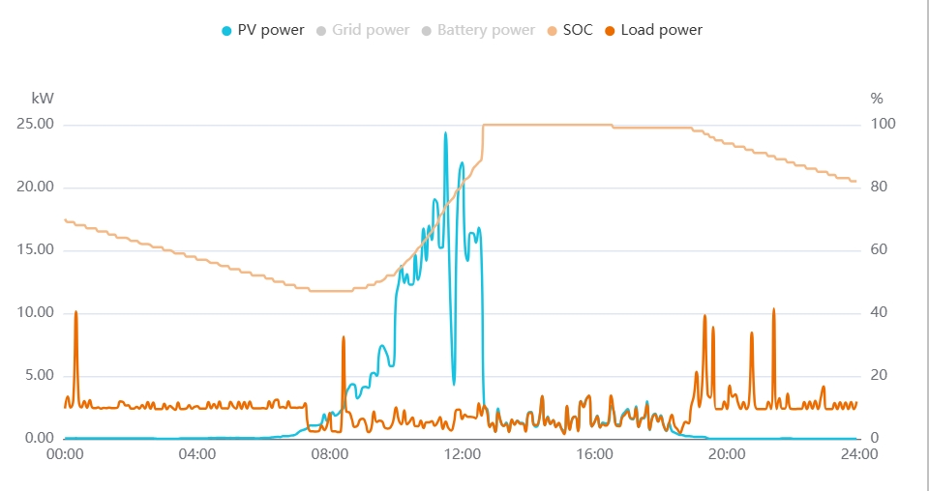
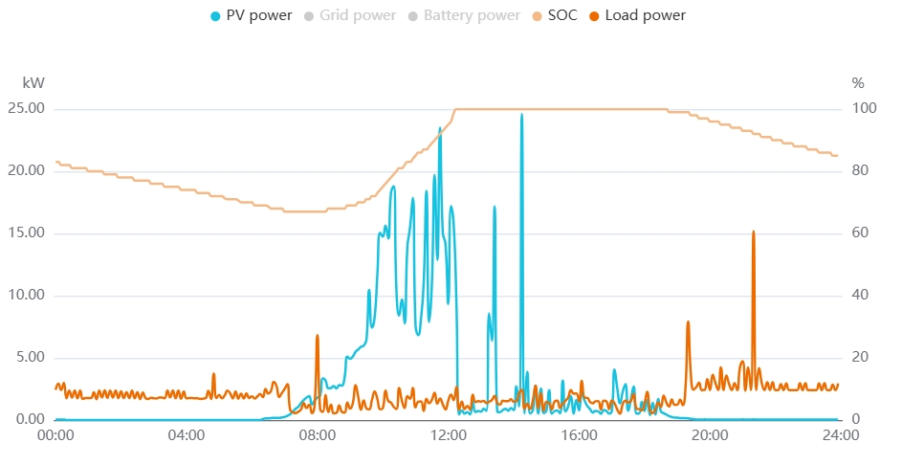

Slide 16
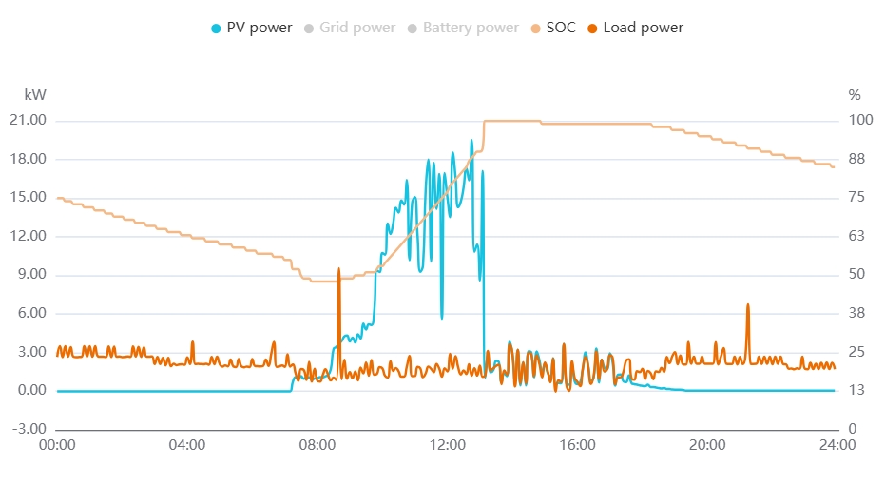

Slide 18
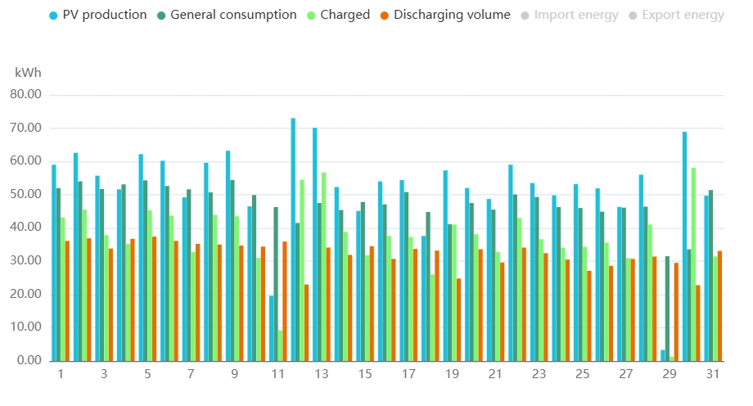

Slide 19
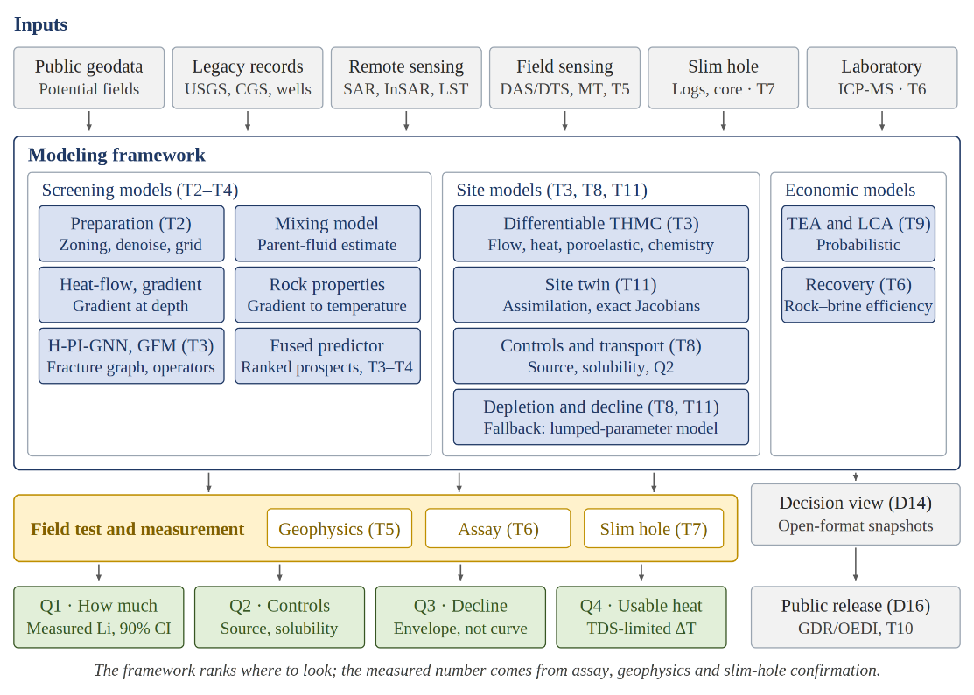

Slide 20
This project will advance domestic critical-mineral and geothermal resource evaluation by determining whether volcanic-hosted systems can support combined geothermal energy production and critical-mineral recovery. The work will quantify lithium, rare earth elements, other critical minerals, major ions, and brine chemistry; identify geological, mineralogical, hydrologic, and geochemical controls on mineral enrichment and mobility; and evaluate how geothermal temperature and lithium concentration may decline under production or circulation. Colorado will serve as the anchor field area, with emphasis on Mount Princeton–Chalk Creek in Chaffee County and the San Juan Volcanic Field, while Medicine Lake, McDermitt Caldera, Valles Caldera, and Lanai Volcano will be used to test transferability across volcanic geothermal systems.
The technical approach integrates field sampling, laboratory assays, controlled rock-brine experiments, geophysical sensing, slim-hole confirmation, downhole fluid assays, core characterization, site-twin assimilation, and Artificial Intelligence (AI) and Machine Learning (ML) prediction across a 36-month period of performance. Months 1–12 will establish the data foundation, develop and validate the initial AI and ML screening framework, rank candidate systems, secure field access and permitting readiness, initiate stakeholder engagement, and complete baseline field, geochemical, geophysical, and laboratory characterization. Months 13–24 will field-test ranked targets through sensing, sampling, slim-hole confirmation, downhole fluid assays, core characterization, and initial site-twin assimilation to confirm or falsify lithium and geothermal potential. Months 25–36 will complete resource characterization, depletion analysis, techno-economic analysis, life-cycle analysis, non-proprietary data release, technology transfer, and final reporting.

Slide 21
https://drive.google.com/file/d/1vnmJkgQMDRQvpCIrI984Fvlfsv6CoLXY/view?usp=drive_web

